Slide 1
EYE STATE MONITORING
Using Deep Learning & Computer Vision
Submitted By:-
Kartik Pant

Slide 2
Introduction
Road safety is significantly impacted by drowsiness or weariness, which is a primary contributor to auto accidents. If drowsy drivers are informed in advance, many fatal incidents can be avoided. Over the past 20 to 30 years, the number of road accidents and injuries in India has been rising alarmingly. According to the experts, the main cause of this issue is that drivers who do not take frequent rests when travelling long distances run a great danger of becoming drowsy, which they frequently fail to identify early enough. There are several drowsiness detection techniques that track a driver's level of tiredness while they are operating a vehicle and alert them if they are not paying attention to the road. This study describes a noncontact way for determining a driver's tiredness utilising detecting techniques.

Slide 3
Problem Idetification
Drowsiness is a condition that exists between being awake and asleep and may be defended by the steady decline in cortical cognitive power. Additionally, a desire or tendency to sleep is connected to it.
Human performance factors essential to safe driving, such as response time, attentiveness, and information processing, are impacted by drowsiness.
Thus, for professional or specific drivers, a real-time drowsy driver evaluation system that alerts the driver when the first signs of exhaustion arise can prevent collisions by avoiding and minimizing sleep episodes.
In this model, a technique for sleepiness detection based on adjustments in image processing is proposed.

Slide 4
Data Collection
The drowsiness data is publically available at http://mrl.cs.vsb.cz/eyedataset which contains more than 80,000 eye images.
The dataset provides a clear understanding of the different eye conditions captured in the dataset.
In addition to the eye condition labels, the dataset also includes several important features that enhance the analysis of driver sleepiness.

Slide 5
Techniques & Algorithms Used
Tensorflow which is a popular framework for machine learning and A.I. .
OpenCV which is a popular computer vision library used for video processing.
Python libraries such as matplotlib & numpy.
CNN ( Convolution Neural Networks) which is highly effective for image classification.
Layers used in the CNN include Conv2D for convolution operations, Zero Padding2D to add rows & coloumns of zero in top ,bottom ,left & right of image, Flatten for converting 2D matrices to 1D, and Dense for fully connected layers.
Scaling pixel values to the [0, 1] range to ensure the model trains effectively .Techniques such as rotation, width shift, height shift, and horizontal flip to artificially expand the training dataset and improve model generalization using image preprocessing and data augmentation.

Slide 6
Con….
Haar Cascades which is an algorithm provided by OpenCV used to detect faces in images.
For activation we use two functions : ReLU (Rectified Linear Unit) is used in the convolutional layers, and sigmoid is used in the output layer for binary classification.
binary_crossentropy is used to measure the performance of the classification model.
Adam optimizer is used to minimize the loss function during training.

Slide 7
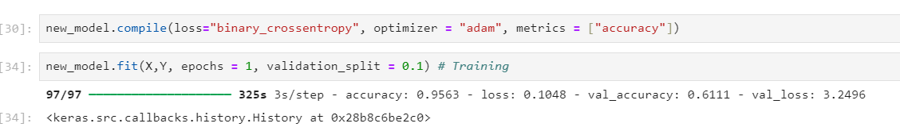
Accuracy

Slide 8
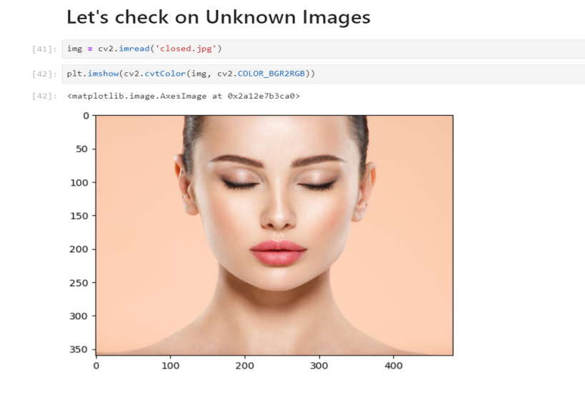
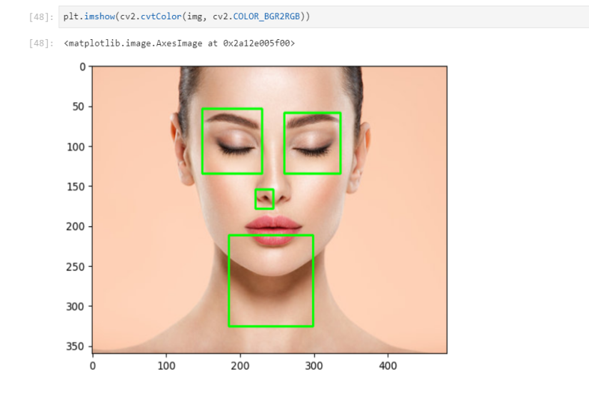
Working & Results
First of all , lets check our model on an unknown image .
Now , by using Haarcascades our model will detect eyes and face in the image.

Slide 9
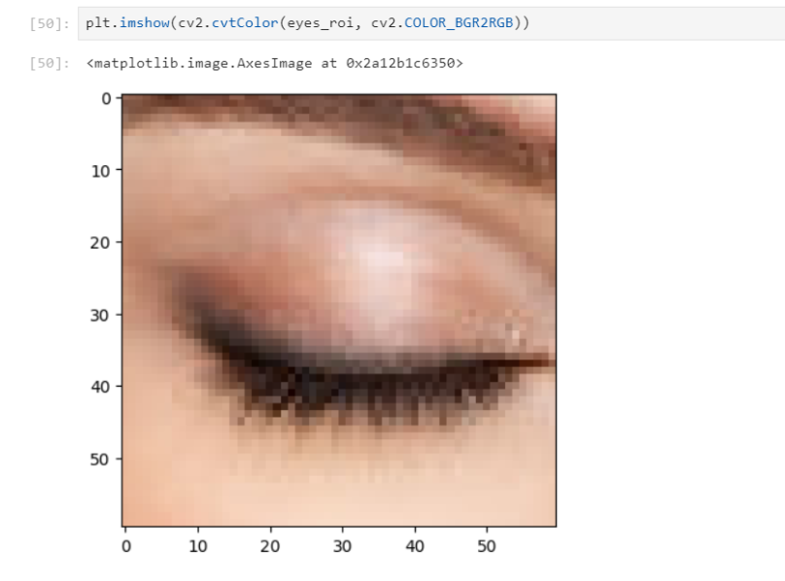
Con….
It will now crop the eye part of the image and check whether if it’s drowsy or alert.
Now if the output value tends near zero the eyes are closed and if it tends near 1 the eyes are open.

Slide 10
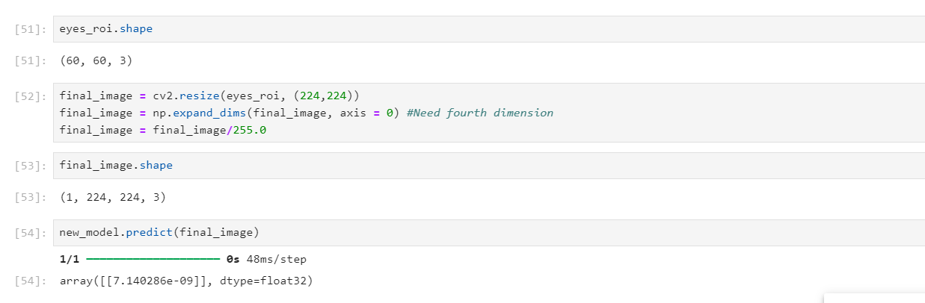
Results
As we can see the value is 7.140286e-09 or we can say 7.140286*10^-9 , the value tends towards zero . Hence we can see the model is working good.

Slide 11
Conclusion & Future work
In conclusion , the drowsiness detection framework can identify laziness and careless practice of drivers.
The suggested model is able to avoid incidents due to sleepiness and laziness.
The model can be incremented by using various other parameters such as blink rate etc.
It can also be used in various streaming platforms such as netlix, prime to close the application when the user falls asleep.

Slide 12
THANK YOU

